Slide 1

SW Code Quality Review Technique Guide
SW Process Unit
LG Electronics Inc.

Slide 2
Document Info
Document Information
Issuing authority | SW Process Unit
Status of document | In Progress / Approved / Released
Revision History
Version | Date | Comment | Author | Approver
1.0 | 2016-08-19 | Initial Release | Hyeuk Kwon | Development Support FD
1.1 | 2018-01-18 | Added the phrase that the development team sets up Code X-ray | Sangju Park | QE Division
1.2 | 2019-02-12 | Organization name change (VC→VS) | Sanghoon Lee | SW Process Team Leader

Slide 3
Contents
SW Code Quality Review Overview
SW Code Quality Review Method
SW Code Quality Review Details 1) SW Code Review
2) SW Static Analysis
3) SW MD

Slide 4
1. SW Code Quality Review Overview
[Purpose of SW Code Quality Review]
The quality of the developed SW code is reviewed to determine the adequacy of the SW code and design, and based on this, it is performed for the purpose of improving the SW design and SW code.
[SW Code Quality Review Method]
SW Code Review
SW Static Analysis
SW MD (Modular Design Metrics)

Slide 5
2. SW Code Quality Review Method
SW Code Quality Review activity is performed as below:
SW Code Review
[Prerequisites] Project Repository must be allocated in Git Server.
[Prerequisites] The execution environment must be established and the person in charge of review must be designated so that Gerrit is performed to reflect the SW code in the Git Server.
SW Engineer requests to reflect the developed SW code in Git Server.
Git Server automatically performs Gerrit to reflect SW code, and the result is delivered to the person in charge of review (SW Architect).
The person in charge of review (SW Architect) checks the result of Gerrit execution and, if there is no problem, performs SW code review to determine whether or not to reflect SW code in Git.
If the result of the Gerrit performance and the code review result of the review person (SW Architect) do not meet the pass criteria, the code reflection must be requested again after modifying the SW code.
SW Static Verification
[Prerequisite] The code must be registered in Git Server by completing SW Code Review.
[Prerequisite] The environment for performing Static Verification of the project must be established by requesting SW Static Verification from the person in charge of SW Static Verification (System ADMIN.).
According to the Static Verification execution cycle (twice a week), Static Verification is automatically performed and the result is registered in the system.
SW Architect reviews SW Static Verification results with SW Engineer at Project Weekly Meeting.
SW Architect assigns SW Engineer to handle Static Verification result issue (bug) in SW Static Verification system.
The assigned SW Engineer establishes a resolution plan for issues (bugs) and registers them in the system.
The assigned SW Engineer modifies the SW code according to the processing plan and reflects it on the Git Server.

Slide 6
2. SW Code Quality Review Method
SW MD
[Prerequisite] The code must be registered in Git Server by completing SW Code Review.
According to the SW MD measurement cycle (once a week), the measurement data defined from the SW code is automatically measured and the result is registered in the system.
SW Architect reviews SW MD results with SW Engineer at Project Weekly Meeting.
SW Architect assigns SW Engineer to deal with items that not satisfy the MD criteria.
The assigned SW Engineer establishes a SW design or SW code improvement plan to satisfy the criteria according to the MD measurement items.
The assigned SW Engineer reviews the SW design or SW code improvement plan with the SW Architect and reflects it in the design and code according to the development process.

Slide 7
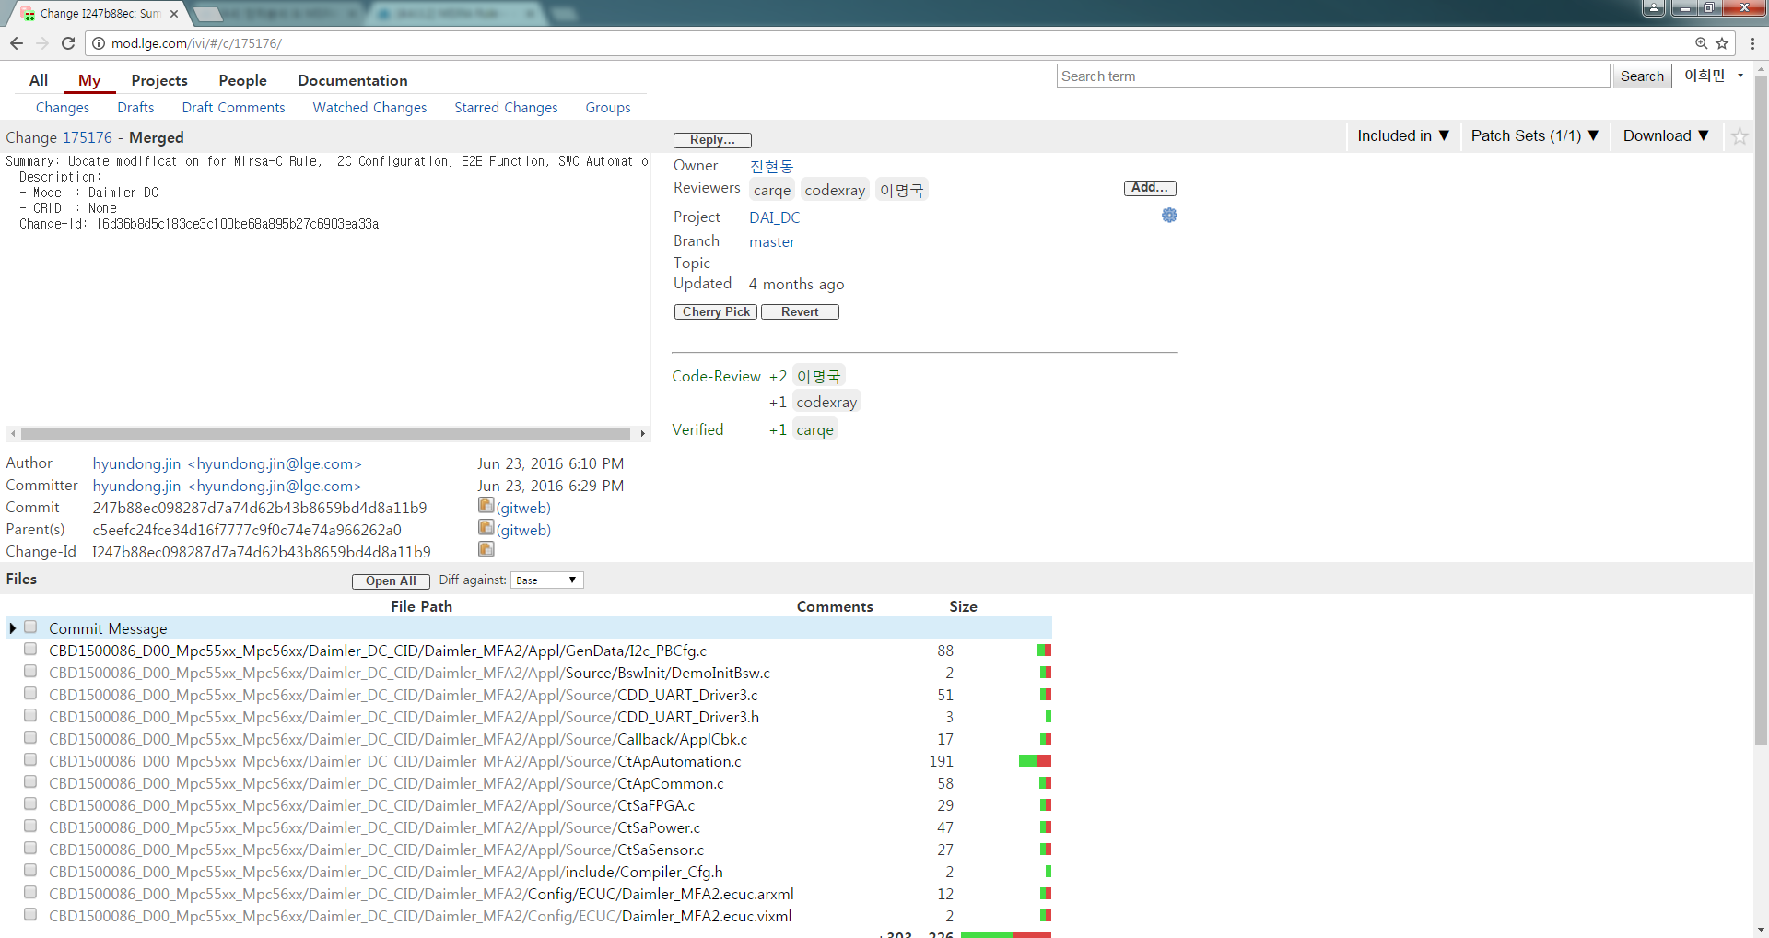
3. SW Code Quality Review – SW Code Review
SW Code Review is performed upon request to reflect the SW code in Git Server, and when the developer uploads the code in Gerrit, it is reviewed by the reviewer.
[SW Code Review Execution Environment & Procedure]

Slide 8
3. SW Code Quality Review – SW Code Review (cont.)
As a result of SW Code Review, the criteria for reflecting the code in Git Server are as follows.
[Git Server Reflection Criteria ]
The results of the three activities below are scored to determine whether to reflect the SW code. When the evaluation score is 4 or higher, it is reflected in Git Server.
Code X-ray : pass point is 1 ( score range : -2 ~ 2)
Compile error : pass point is 1 (score range : -1 or 1)
Reviewer’s review pass point is 2 (score range : -2 ~ 2)
[Code X-ray Execution Condition]
This is done when the development team sets up Code X-ray in Gerrit.
It is performed by the Rule defined in the Code X-ray tool.
http://collab.lge.com/main/display/CODEXRAY/1.+Getting+Started
[Checklist for Reviewer]
The designated reviewer performs code review based on the checklist
Checklist : LGE_VS Smart_VR_C01_VR Checklist_V3.2 (http://collab.lge.com/main/pages/viewpage.action?pageId=803471394)
Code review guide: http://collab.lge.com/main/display/VCSMRTMD/Code+Review+Guidance

Slide 9
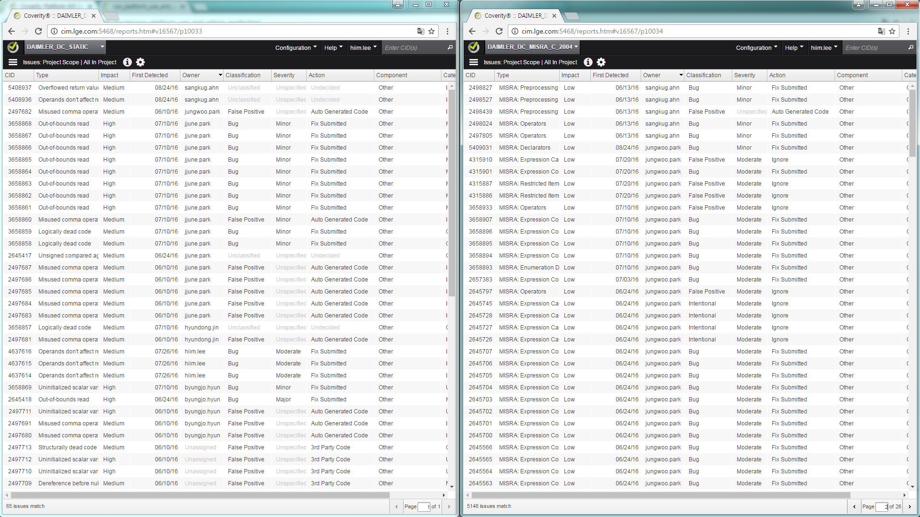
3. SW Code Quality Review – SW Static Verification
SW Static Verification is performed through the Coverity tool, and the result is managed in the system as follows.

Slide 10
3. SW Code Quality Review – SW Static Verification (cont.)
SW Static Verification guidelines are as below.
Static Analysis & MISRA Rule measurement process, criteria : http://collab.lge.com/main/pages/viewpage.action?pageId=579365481
Coverity Review : http://collab.lge.com/main/display/SWIFR/%281%29+Coverity
Coverity Tool guide: http://collab.lge.com/main/display/SWIFR/01.+Coverity+User+Manual
[Static Analysis Rules]
Static Analysis process, guideline : http://collab.lge.com/main/display/SWIFR/%5B1%5D+VS+Static+Analysis+Process
Static Analysis Checker list: http://collab.lge.com/main/display/SWIFR/0.+Enabled+Coverity+Checkers
[MISRA C/C++]
MISRA Rule : http://collab.lge.com/main/display/SWIFR/MISRA+C-2012+Coverage

Slide 11
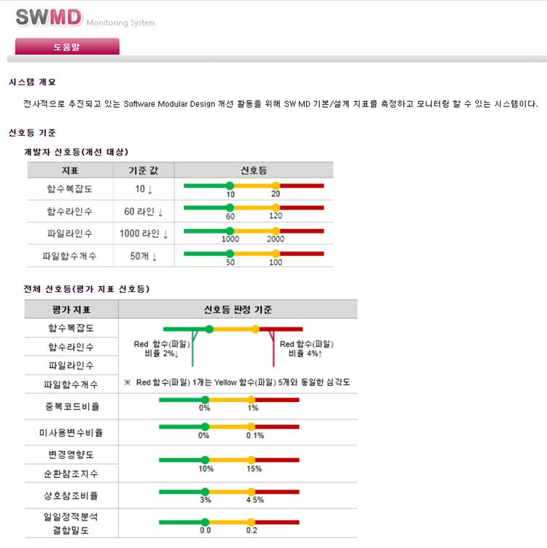
3. SW Code Quality Review – SW MD
SWMD is a design quality measurement index defined for software modular design improvement activities that are being promoted company-wide, and is measured and managed in the SWMD system as follows.
http://vsmd.lge.com/division/

Slide 12
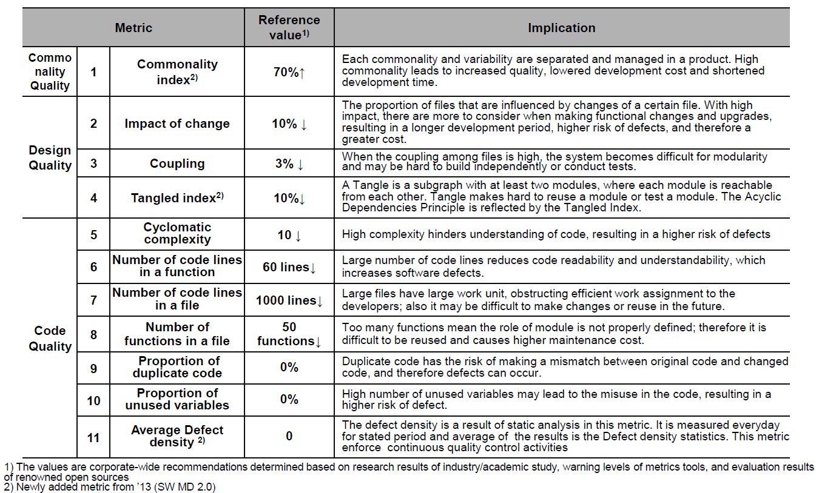
3. SW Code Quality Review – SW MD (cont.)
Among the SW MD indicators, the developer improvement evaluation indicators that the developer should directly check and improve are as follows. For the measurement criteria for each measurement indicator, refer to the attached SW MD standard.
Metrics for developers to improve

Slide 13
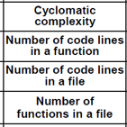
3. SW Code Quality Review – SW MD (cont.)
The evaluation / improvement criteria of the developer improvement evaluation index are as follows.
In the evaluation criteria, the improvement of SW design and SW code is judged according to the severity of the violation (traffic light).
Red traffic lights must be improved.
Yellow traffic lights do not necessarily have to be improved, but improvements can be considered to increase design quality.
The developer improvement evaluation indicator is displayed in two stages.
The criteria for judging traffic lights at the level of detail of
functions and files are as follows.
At a high level, the criteria for judging traffic lights are as follows.

Slide 14
End of Document

